Slide 1
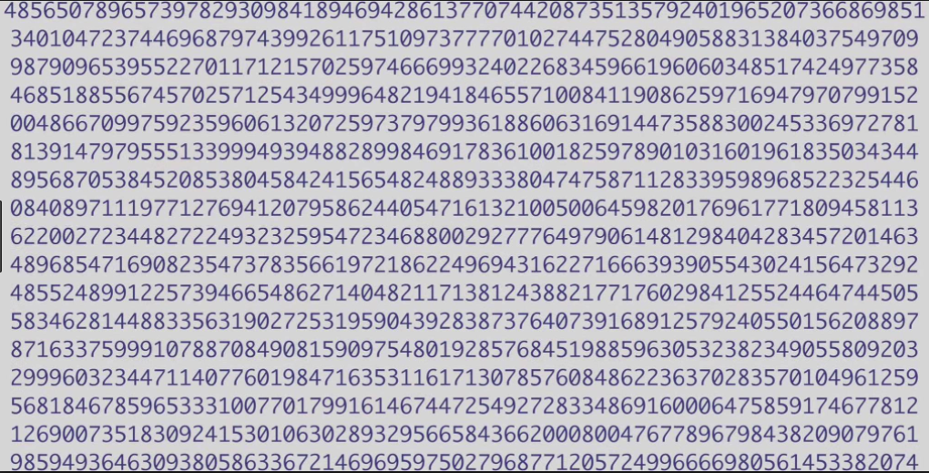
This number is illegal
Let’s find out why!

Slide 2
2 13 29
60 27 15
Notes:
Ask the class to identify the numbers that belong above the line and those that belong below the line. Through discussion, in which students look for patterns, hypothesise and reason, establish that numbers above the line are prime numbers and that numbers below the line are composite numbers. This may take a bit of trial and error to establish the grouping.
Discuss the definitions of prime and composite numbers. Establish that, for ease of definition, a prime number 1 is not considered a prime number. A prime whole number has to be greater than 1 and only divisible by itself and 1; so it only has factors of 1 and itself.
http://www.scootle.edu.au/ec/viewing/S8021/Maths_template_prime_numbers/index.html

Slide 3
1 | 2 | 3 | 4 | 5 | 6 | 7 | 8 | 9 | 10
11 | 12 | 13 | 14 | 15 | 16 | 17 | 18 | 19 | 20
21 | 22 | 23 | 24 | 25 | 26 | 27 | 28 | 29 | 30
31 | 32 | 33 | 34 | 35 | 36 | 37 | 38 | 39 | 40
41 | 42 | 43 | 44 | 45 | 46 | 47 | 48 | 49 | 50
51 | 52 | 53 | 54 | 55 | 56 | 57 | 58 | 59 | 60
61 | 62 | 63 | 64 | 65 | 66 | 67 | 68 | 69 | 70
71 | 72 | 73 | 74 | 75 | 76 | 77 | 78 | 79 | 80
81 | 82 | 83 | 84 | 85 | 86 | 87 | 88 | 89 | 90
91 | 92 | 93 | 94 | 95 | 96 | 97 | 98 | 99 | 100
Notes:
Hand out the students the hundreds square worksheet

Slide 4
24
7
30
Special numbers review
Date
EQ – What are primes, composites, perfect squares and triangular numbers
1 | 2 | 3 | 4 | 5 | 6 | 7 | 8 | 9 | 10
11 | 12 | 13 | 14 | 15 | 16 | 17 | 18 | 19 | 20
21 | 22 | 23 | 24 | 25 | 26 | 27 | 28 | 29 | 30
31 | 32 | 33 | 34 | 35 | 36 | 37 | 38 | 39 | 40
41 | 42 | 43 | 44 | 45 | 46 | 47 | 48 | 49 | 50
51 | 52 | 53 | 54 | 55 | 56 | 57 | 58 | 59 | 60
61 | 62 | 63 | 64 | 65 | 66 | 67 | 68 | 69 | 70
71 | 72 | 73 | 74 | 75 | 76 | 77 | 78 | 79 | 80
81 | 82 | 83 | 84 | 85 | 86 | 87 | 88 | 89 | 90
91 | 92 | 93 | 94 | 95 | 96 | 97 | 98 | 99 | 100
Notes:
Crossing out all 2s, gets rid of all the even numbers except 2. (Note, 1 is not a prime).
Then cross out all multiples of 3s, then all multiples of 5.

Slide 5
24
7
30
Special numbers review
Date
EQ – What are primes, composites, perfect squares and triangular numbers
1 | 2 | 3 | 4 | 5 | 6 | 7 | 8 | 9 | 10
11 | 12 | 13 | 14 | 15 | 16 | 17 | 18 | 19 | 20
21 | 22 | 23 | 24 | 25 | 26 | 27 | 28 | 29 | 30
31 | 32 | 33 | 34 | 35 | 36 | 37 | 38 | 39 | 40
41 | 42 | 43 | 44 | 45 | 46 | 47 | 48 | 49 | 50
51 | 52 | 53 | 54 | 55 | 56 | 57 | 58 | 59 | 60
61 | 62 | 63 | 64 | 65 | 66 | 67 | 68 | 69 | 70
71 | 72 | 73 | 74 | 75 | 76 | 77 | 78 | 79 | 80
81 | 82 | 83 | 84 | 85 | 86 | 87 | 88 | 89 | 90
91 | 92 | 93 | 94 | 95 | 96 | 97 | 98 | 99 | 100
Notes:
Crossing out all 2s, gets rid of all the even numbers except 2. (Note, 1 is not a prime).
Then cross out all multiples of 3s, then all multiples of 5.

Slide 6
24
7
30
Special numbers review
Date
EQ – What are primes, composites, perfect squares and triangular numbers
1 | 2 | 3 | 4 | 5 | 6 | 7 | 8 | 9 | 10
11 | 12 | 13 | 14 | 15 | 16 | 17 | 18 | 19 | 20
21 | 22 | 23 | 24 | 25 | 26 | 27 | 28 | 29 | 30
31 | 32 | 33 | 34 | 35 | 36 | 37 | 38 | 39 | 40
41 | 42 | 43 | 44 | 45 | 46 | 47 | 48 | 49 | 50
51 | 52 | 53 | 54 | 55 | 56 | 57 | 58 | 59 | 60
61 | 62 | 63 | 64 | 65 | 66 | 67 | 68 | 69 | 70
71 | 72 | 73 | 74 | 75 | 76 | 77 | 78 | 79 | 80
81 | 82 | 83 | 84 | 85 | 86 | 87 | 88 | 89 | 90
91 | 92 | 93 | 94 | 95 | 96 | 97 | 98 | 99 | 100
Notes:
The numbers left are prime.
Note for extension group – to test for the presence of primes we only had to cross out multiples up to square root of our highest number (+1 in this case) 100^0.5 = 10, so 11 was the highest multiple we had to test for.

Slide 7
Where are prime numbers used?
In cryptography – information security, credit card payments, passwords, military communication – anywhere you want to keep a message secret.
Why is the above prime number illegal?
Because if you use this above prime number you can decode the DRM (Digital Rights Management) on things like DVDs with copy protection.
(I changed a single number on the above prime number to make sure I don’t get in trouble. Really!).
Notes:
Seriously, there is one additional digit in the above sequence.

Slide 8
24
7
30
Special numbers review
Date
EQ – What are primes, composites, perfect squares and triangular numbers
A prime whole number has to be greater than 1 and only divisible by itself and 1; so it only has factors of 1 and itself.
A composite number is a whole number greater than 1 that is not a prime number. This means it has more factors than just itself and 1.
For example 12 has the following factors

Slide 9
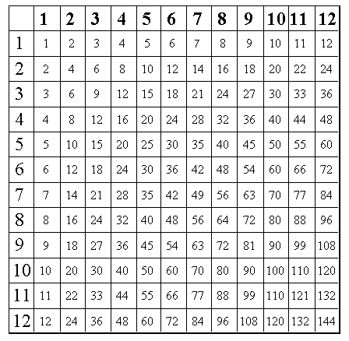
24
7
30
Special numbers review
Date
EQ – What are primes, composites, perfect squares and triangular numbers
For example 12 has the following factors 1, 2, 3, 4, 6, 12
Notes:
Circle all the 12s in the multiplication table.
In one colour shade in the squares to make 2 x 6 = 12, point out that all composite numbers can be made up by rectangles on a multiplication table.
Next discuss what happens for 2 x 2 = It makes a square and not a rectangle
Then 3 x 3 makes a square, etc, etc. Highlight the square numbers

Slide 10
24
7
30
Special numbers review
Date
EQ – What are primes, composites, perfect squares and triangular numbers
A prime whole number has to be greater than 1 and only divisible by itself and 1; so it only has factors of 1 and itself.
A composite number is a whole number greater than 1 that is not a prime number. This means it has more factors than just itself and 1.
For example 12 has the following factors: 1, 2, 3, 4, 6, 12
A Perfect Square is a number that can be expressed as the product of two equal integers. (It’s what happens when you multiply a whole number by the same whole number).
Notes:
Circle all the 12s in the multiplication table.
In one colour shade in the squares to make 2 x 6 = 12, point out that all composite numbers can be made up by rectangles on a multiplication table.
Next discuss what happens for 2 x 2 = It makes a square and not a rectangle
Then 3 x 3 makes a square, etc, etc. Highlight the square numbers

Slide 11
24
7
30
Special numbers review
Date
EQ – What are primes, composites, perfect squares and triangular numbers
Triangular numbers are formed by adding up all the whole numbers
1
3
6
10
15
21
28
36
45
55
+ 2
+ 3
+ 4
+ 5
+ 6
+ 7
+ 8
+ 9
+ 10
The numbers have a pattern as shown.
We can continue the pattern.
Another way of showing the pattern of dots is:

Slide 12
24
7
30
Special numbers review - Extension
Date
EQ – What are primes, composites, perfect squares and triangular numbers
Get into groups of 3 or 4
One of you will play the role of a new student at school. On the first day you meet 1 new person and shake their hand.
On the second day you meet 2 more new people and shake their hand. How many people have you met so far?
One the third day you meet 3 more new people. Now how many people have you met?
On the fourth day you meet 4 more new people…..
Extension question: On what day will you meet 100 or more new people?

